Slide 1
Wednesday, August 16, 2017
Write In Your Agenda:
Write In Your Monitoring Log:
CW:
Review Homework
Finish Metric System Poof Book
HW:
Metric System Homework Sheet.
Study for Metric System Quiz on Monday 8/21/17!
Response to Warm-Up:
What important event will take place on August 21?
You will need:
Pencil
Agenda
Monitoring Log
Last Night’s Homework

Slide 2
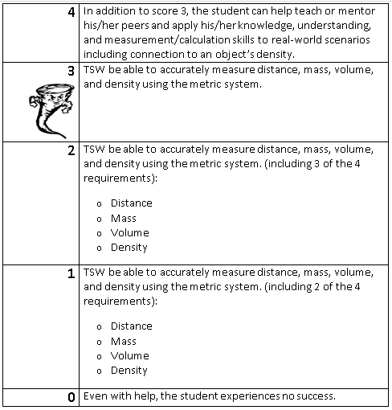
Learning Goal and Scale
TSW be able to accurately measure distance, mass, volume, and density using the metric system.

Slide 3
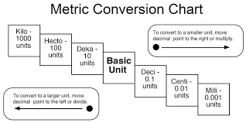

Slide 4
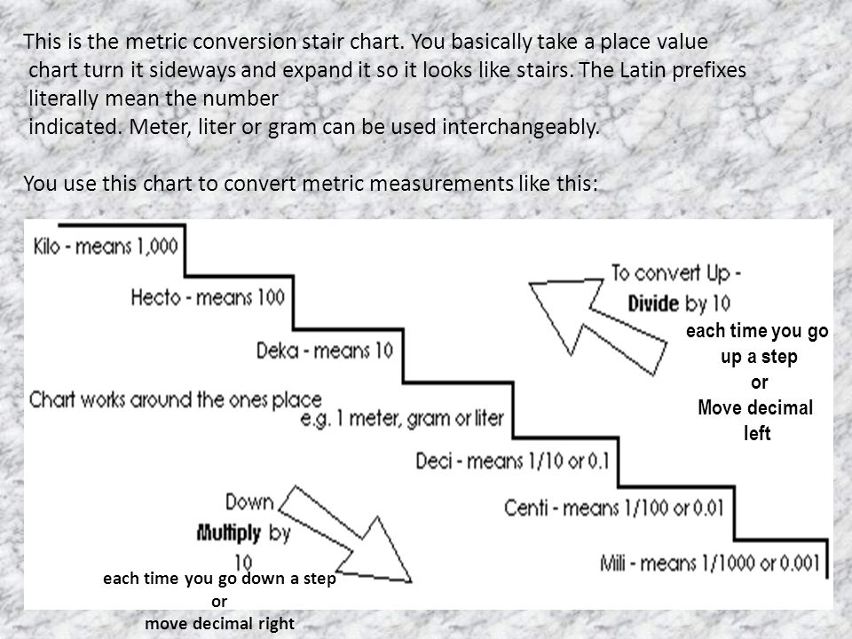

Slide 5
